Slide 1
Chapter 5
Sequential Circuits
AASTU/Software Engineering

Slide 2
Objectives
Sequential Circuits
Storage Elements (Memory)
  Latches
  Flip-Flops
AASTU/Software Engineering

Slide 3
Combinational vs Sequential
Combinational
Circuits
inputs X
outputs Z
A combinational circuit:
At any time, outputs depends only on inputs
  Changing inputs changes outputs
No regard for previous inputs
  No memory (history)
Time is ignored !
AASTU/Software Engineering

Slide 4
Combinational vs Sequential
Combinational
Circuits
inputs X
outputs Z
present state
next state
Memory
A sequential circuit:
A combinational circuit with feedback through memory
  The stored information at any time defines a state
Outputs depend on inputs and previous inputs
  Previous inputs are stored as binary information into memory
Next state depends on inputs and present state
AASTU/Software Engineering

Slide 5


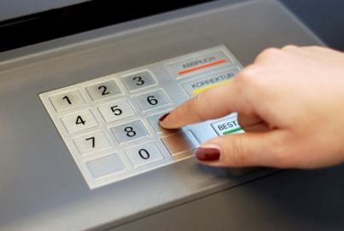
Examples of sequential systems
Traffic light
ATM
Vending machine
What is common between these systems?
AASTU/Software Engineering

Slide 6
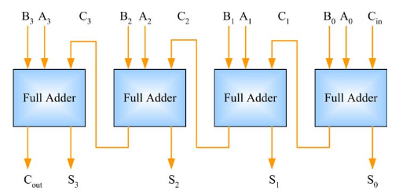
Combinational Adder
4-bit adder (ripple-carry)
  Notice how carry-out propagates
  One adder is active at a time
4 full adders are needed
AASTU/Software Engineering

Slide 7
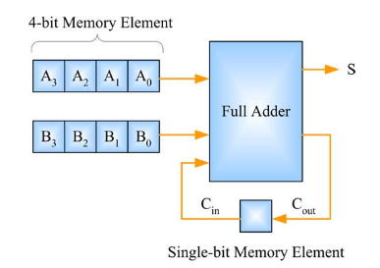
Sequential Adder
1-bit memory and 2 4-bit memory
Only one full-adder!
4 clocks to get the output
The 1-bit memory defines the circuit state (0 or 1)
AASTU/Software Engineering

Slide 8
Types of Sequential Circuits
Two types of sequential circuits:
  Synchronous: The behavior of the circuit depends on the input signal at discrete instances of time (also called clocked)
  Asynchronous: The behavior of the circuit depends on the input signals at any instance of time and the order of the inputs change
    A combinational circuit with feedback
AASTU/Software Engineering

Slide 9
Synchronous Sequential Circuits
Combinational
Circuits
inputs X
outputs Z
present state
next state
Flip-Flops
clock
Synchronous circuits employ a synchronizing signal called clock (a periodic train of pulses; 0s and 1s)
A clock determines when computational activities occur
Other signals determines what changes will occur
AASTU/Software Engineering

Slide 10
Synchronous Sequential Circuits
Combinational
Circuits
inputs X
outputs Z
present state
next state
Flip-Flops
clock
The storage elements (memory) used in clocked sequential circuits are called flip-flops
  Each flip-flop can store one bit of information 0,1
  A circuit may use many flip-flops; together they define the circuit state
Flip-Flops (memory/state) update only with the clock
AASTU/Software Engineering

Slide 11
Storage Elements (Memory)
A storage element can maintain a binary state (0,1) indefinitely, until directed by an input signal to switch state
Main difference between storage elements:
  Number of inputs they have
  How the inputs affect the binary state
Two main types:
  Latches (level-sensitive)
  Flip-Flops (edge-sensitive)
Latches are useful in asynchronous sequential circuits
Flip-Flips are built with latches
AASTU/Software Engineering

Slide 12
Latches
A latch is binary storage element
Can store a 0 or 1
The most basic memory
Easy to build
  Built with gates (NORs, NANDs, NOT)
AASTU/Software Engineering

Slide 13
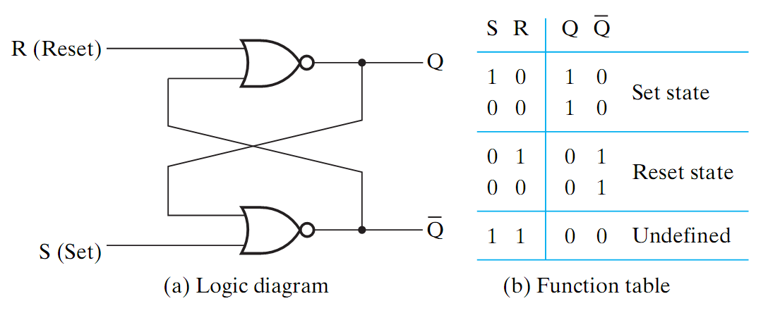
SR Latch
What does this circuit do?
AASTU/Software Engineering

Slide 14
SR Latch
Two states: Set (Q = 1) and Reset (Q = 0)
When S=R=0, Q remains the same, S=R=1 is not allowed!
Normally, S=R=0 unless the state need to be changed (memory?)
State of the circuit depends not only on the current inputs, but also on the recent history of the inputs
AASTU/Software Engineering

Slide 15
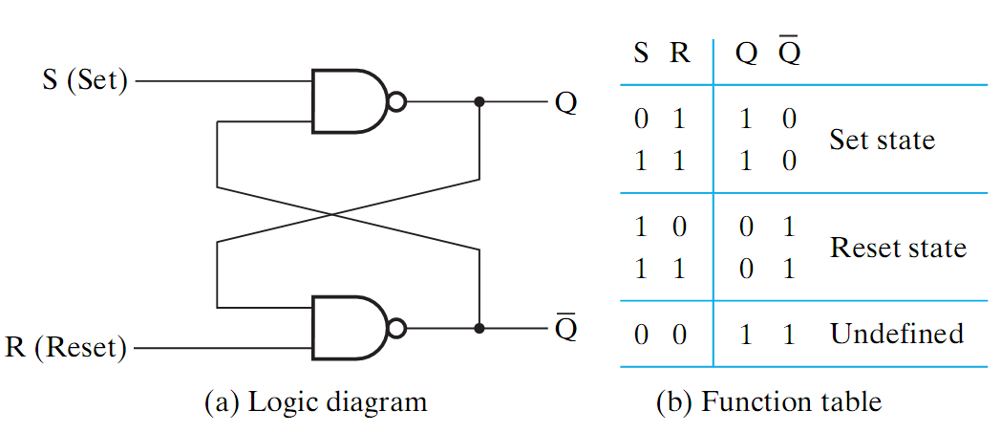
S’ R’ Latch
How about this circuit?
AASTU/Software Engineering

Slide 16
S’ R’ Latch
Similar to SR latch (complemented)
Two states: Set (Q = 1) and Reset (Q = 0)
When S=R=1, Q remains the same
S=R=0 is not allowed!
AASTU/Software Engineering

Slide 17
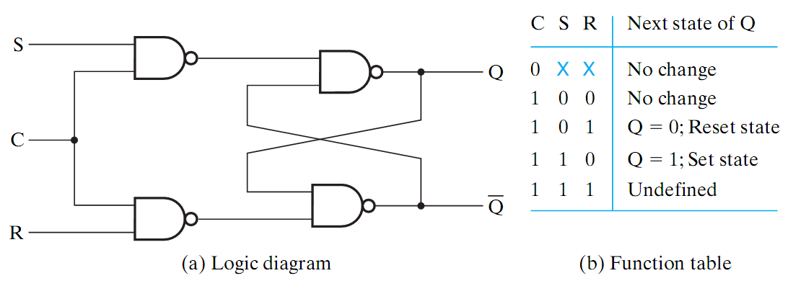
SR Latch with Clock
An SR Latch can be modified to control when it changes
An additional input signal Clock (C)
When C=0, the S and R inputs have no effect on the latch
When C=1, the inputs affect the state of the latch and possibly the output
AASTU/Software Engineering

Slide 18
SR Latch with Clock (cont.)
How can we eliminate the undefined state?
AASTU/Software Engineering

Slide 19
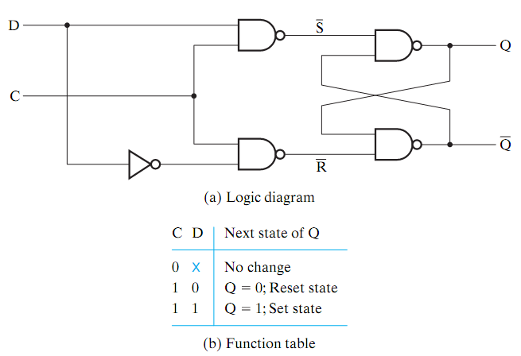
D Latch
S
Ensure S and R are never equal to 1 at the same time
Add inverter
Only one input (D)
  D connects to S
  D’ connects to R
D stands for data
Output follows the input when C = 1
  Transparent
When C = 0, Q remains the same
R
AASTU/Software Engineering

Slide 20
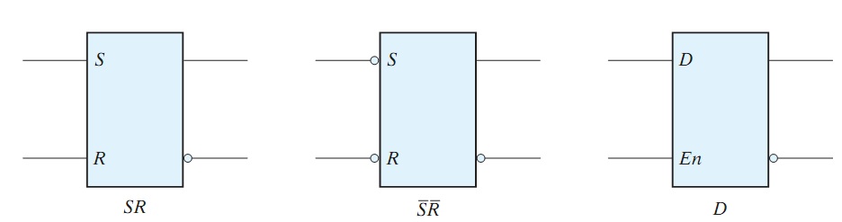
Graphic Symbols for Latches
clk
A latch is designated by a rectangular block with inputs on the left and outputs on the right
One output designates the normal output, the other (with the bubble) designates the complement
For S’R’ (SR built with NANDs), bubbles added to the input
AASTU/Software Engineering

Slide 21
Problem with Latches
Combinational
Circuits
inputs X
outputs Z
Latches?
clock
Example
What happens if Clock=1? What will be the value of Q when Clock goes to 0?
Problem: A latch is transparent; state keep changing as long as the clock remains active
Due to this uncertainty, latches can not be reliably used as storage elements.
D
Q
Q
Clock
C
Q
AASTU/Software Engineering

Slide 22
Flip Flops
A flip-flop is a one bit memory similar to latches
Solves the issue of latch transparency
Latches are level sensitive memory element
  Active when the clock = 1 (whole duration)
Flip-Flops are edge-triggered or edge-sensitive memory element
  Active only at transitions; i.e. either from 0 → 1 or 1 → 0
level
positive (rising) edge
negative (falling) edge
AASTU/Software Engineering

Slide 23
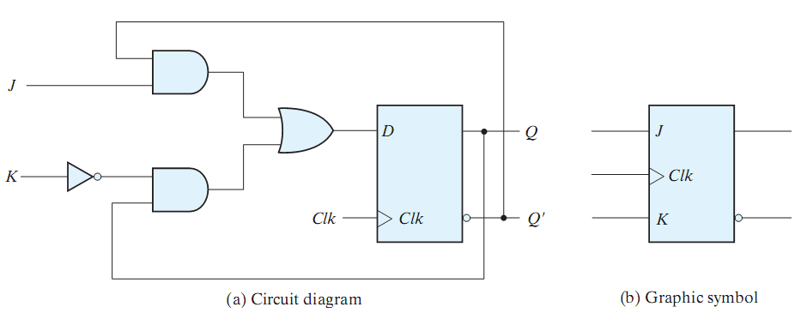
other Flip Flops
JK Flip Flop
How does it work?
Hint: D = ?
AASTU/Software Engineering

Slide 24
Other Flip Flops
JK Flip Flop
D = J Q’ + K’ Q
J sets the flip flop (1)
K reset the flip flop (0)
When J = K = 1, the output is complemented
AASTU/Software Engineering

Slide 25
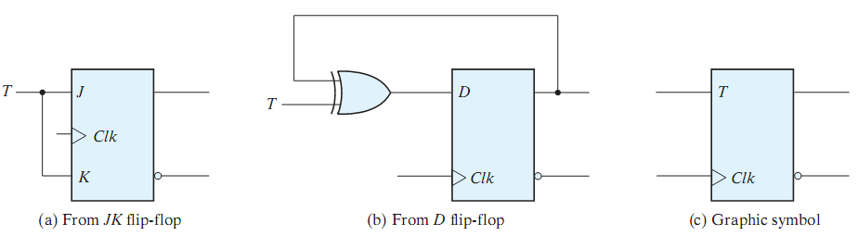
Other Flip Flops (cont.)
T Flip Flop
T (toggle) flip flop is a complementing flip flop
Built with a JK or D flip flop (as shown above)
T = 0, no change,
T = 1, complement (toggle)
For D-FF implementation, D = T ⊕ Q
AASTU/Software Engineering

Slide 26
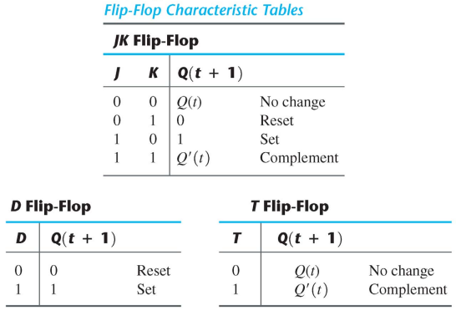
Characteristic Tables
A characteristic table defines the operation of a flip flop in a tabular form
Next state is defined in terms of the current state and the inputs
  Q(t) refers to current state (before the clock arrives)
  Q(t+1) refers to next state (after the clock arrives)
Similar to the truth table in combinational circuits
AASTU/Software Engineering

Slide 27
Characteristic Equations
A characteristic equation defines the operation of a flip flop in an algebraic form
For D-FF
  Q(t+1) = D
For JK-FF
  Q(t+1) = J Q’ + K’ Q
For T-FF
  Q(t+1) = T ⊕ Q
AASTU/Software Engineering

Slide 28
Analysis of Sequential Circuits
Analysis is describing what a given circuit will do
The behavior of a clocked (synchronous) sequential circuit is determined from the inputs, the output, and the states of FF
Steps:
  Obtain state equations
    FF input equations
    Output equations
  Fill the state table
    Put all combinations of inputs and current states
    Fill the next state and output
  Draw the state diagram
AASTU/Software Engineering

Slide 29
Analysis of Combinational vs Sequential Circuits
Combinational :
Boolean Equations
Truth Table
Output as a function of inputs
Sequential :
State Equations
State Table
State Diagram
Output as a function of input and current state
Next state as a function of inputs and current state.
AASTU/Software Engineering

Slide 30
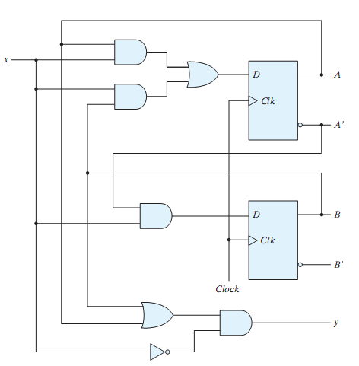
State Equations
A state equation is a Boolean expression which specifies the next state and output as a function of the present state and inputs.
Example:
The shown circuit has two D-FFs (A,B), an input x and output y.
The D input of a FF determines the next state
  A(t+1) = A(t)x+B(t)x = Ax+Bx
  B(t+1) = A’(t)x = A’x
Output:
  y = (A+B)x’
AASTU/Software Engineering

Slide 31
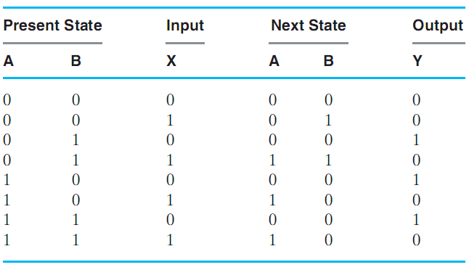
State Table
A state table is a table enumerating all present states, inputs, next states and outputs.
Present state, inputs: list all combinations
Next states, outputs: derived from state equations
4 sections
AASTU/Software Engineering

Slide 32
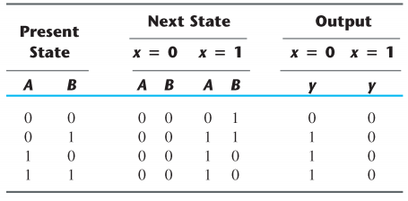
State Table
A state table is a table enumerating all present states, inputs, next states and outputs.
Present state, inputs: list all combinations
Next states, outputs: derived from state equations
2-D Form
AASTU/Software Engineering

Slide 33
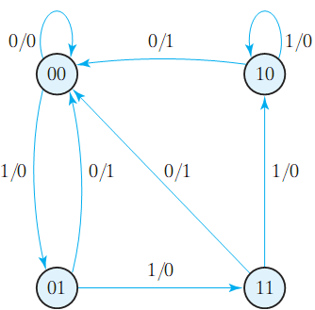
State Diagram
The state diagram is a graphical representation of a state table (provides same information)
Circles are states (FFs), Arrows are transitions between states
Labels of arrows represent inputs and outputs
AASTU/Software Engineering

Slide 34
Analysis of Sequential Circuits
Analysis is describing what a given circuit will do
The behavior of a clocked (synchronous) sequential circuit is determined from the inputs, the output, and the states of FF
Steps:
  Obtain state equations
    FF input equations
    Output equations
  Fill the state table
    Put all combinations of inputs and current states
    Fill the next state and output
  Draw the state diagram
AASTU/Software Engineering

Slide 35
Example 1
Analyze this circuit?
Is this a sequential circuit? Why?
How many inputs?
How many outputs?
How many states?
What type of memory?
AASTU/Software Engineering

Slide 36
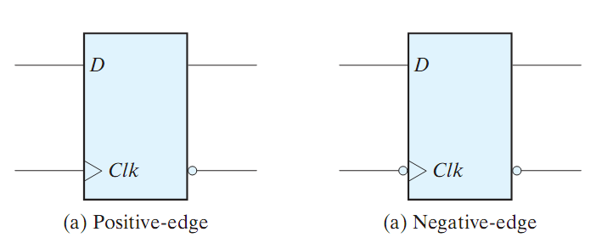
Example 1 (cont.)
D Flip Flop (review)
Characteristic Tables and Equations
Q(t) | D | Q(t+1)
0 | 0 | 0
0 | 1 | 1
1 | 0 | 0
1 | 1 | 1
D | Q(t+1)
0 | 0
1 | 1
Q(t+1) = D
AASTU/Software Engineering

Slide 37
Example 1 (cont.)
AASTU/Software Engineering

Slide 38
Example 1 (cont.)
State equations:
D_{A} = AX + BX
D_{B} = A’ X
Y = (A + B) X’
AASTU/Software Engineering

Slide 39
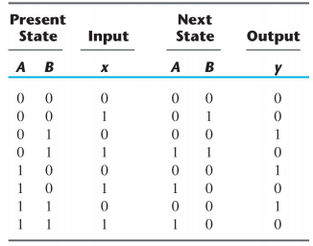
Example 1 (cont.)
State equations:
D_{A} = AX + BX
D_{B} = A’ X
Y = (A + B) X’
State table:
AASTU/Software Engineering

Slide 40
Example 1 (cont.)
State equations:
D_{A} = AX + BX
D_{B} = A’ X
Y = (A + B) X’
State table (2D):
AASTU/Software Engineering

Slide 41
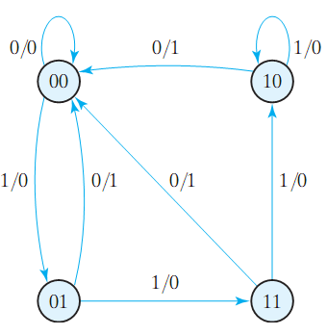
Example 1 (cont.)
State equations:
D_{A} = AX + BX
D_{B} = A’ X
Y = (A + B) X’
State table:
State diagram:
AASTU/Software Engineering

Slide 42
State Reduction
Two sequential circuits may exhibits the same input-output behavior, but have a different number of states
State Reduction: The process of reducing the number of states, while keeping the input-output behavior unchanged.
It results in less Flip flops
It may increase the combinational logic!
AASTU/Software Engineering

Slide 43
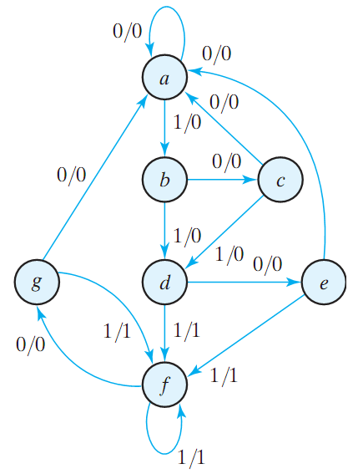
State Reduction (Example)
Is it possible to reduce this FSM?
How many states?
How many input/outputs?
Notes:
we use letters to denote states rather than binary codes
we only consider input/output sequence and transitions
AASTU/Software Engineering

Slide 44
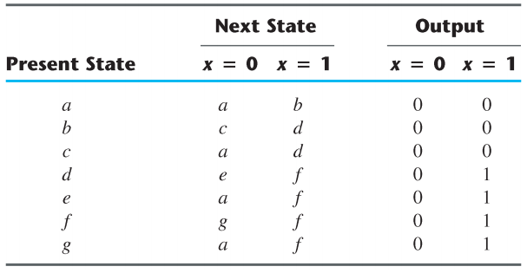
State Reduction (Example)
Step 1: get the state table
AASTU/Software Engineering

Slide 45
State Reduction (Example)
Step 1: get the state table
Step 2: find similar states
e and g are equivalent states
remove g and replace it with e
AASTU/Software Engineering

Slide 46
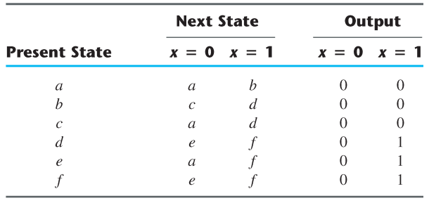
State Reduction (Example)
Step 1: get the state table
Step 2: find similar states
e and g are equivalent states
remove g and replace it with e
AASTU/Software Engineering

Slide 47
State Reduction (Example)
Step 1: get the state table
Step 2: find similar states
d and f are equivalent states
remove f and replace it with d
AASTU/Software Engineering

Slide 48
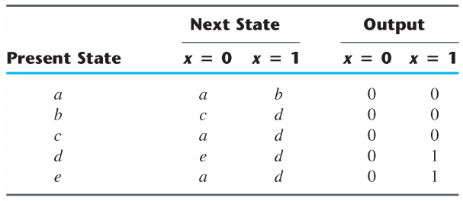
State Reduction (Example)
Step 1: get the state table
Step 2: find similar states
d and f are equivalent states
remove f and replace it with d
AASTU/Software Engineering

Slide 49
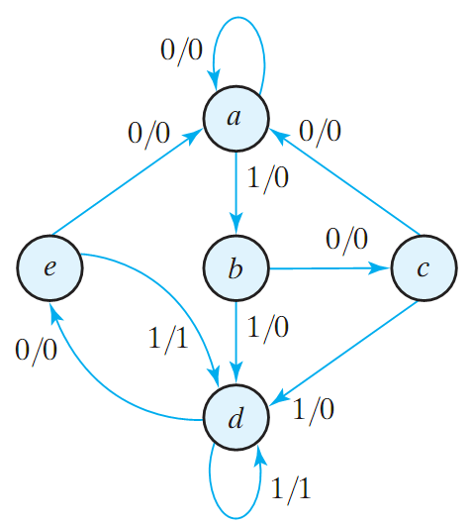
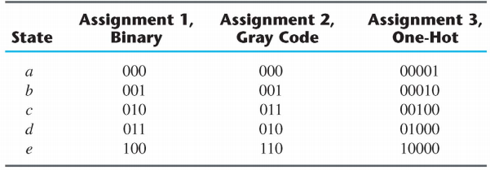
State Assignmnet
State Assignment: Assign unique binary codes to the states
For m states, we need ⎡ log₂ m ⎤ bits (FF)
Example
Three Possible Assignments:
AASTU/Software Engineering

Slide 50
Design of Synchronous Sequential Circuits
The design of a clocked sequential circuit starts from a set of specifications and ends with a logic diagram (Analysis reversed!)
Building blocks: flip-flops, combinational logic
Need to choose type and number of flip-flops
Need to design combinational logic together with flip-flops to produce the required behavior
The combinational part is
  flip-flop input equations
  output equations
AASTU/Software Engineering

Slide 51
Design of Synchronous Sequential Circuits
Design Procedure:
  Obtain a state diagram from the word description
    State reduction if necessary
  Obtain State Table
    State Assignment
    Choose type of flip-flops
    Use FF’s excitation table to complete the table
  Derive state equations
    Obtain the FF input equations and the output equations
    Use K-Maps
  Draw the circuit diagram
AASTU/Software Engineering

Slide 52
Step1: Obtaining the State Diagram
A very important step in the design procedure.
Needs Practice!
Example: Design a circuit that detects a sequence of three consecutive 1’s in a string of bits coming through an input line (serial bit stream)
AASTU/Software Engineering

Slide 53
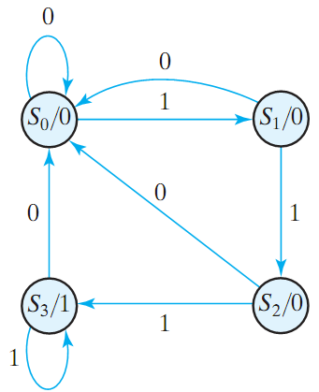
Step1: Obtaining the State Diagram
A very important step in the design procedure.
Requires experience!
Example: Design a circuit that detects a sequence of three consecutive 1’s in a string of bits coming through an input line (serial bit stream)
AASTU/Software Engineering

Slide 54
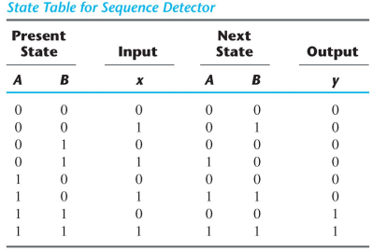
Step2: Obtaining the State Table
Assign binary codes for the states
We choose 2 D-FF
  Next state specifies what should be the input to each FF
Example: Design a circuit that detects a sequence of three consecutive 1’s in a string of bits coming through an input line (serial bit stream)
AASTU/Software Engineering

Slide 55


Step3: Obtaining the State Equations
Using K-Maps
A(t + 1) = D_{A} = ∑(3,5,7) = A x + B x
B(t + 1) = D_{B} = ∑(1,5,7) = A x + B’ x
y = ∑(6,7) = A B
Example: Design a circuit that detects a sequence of three consecutive 1’s in a string of bits coming through an input line (serial bit stream)
AASTU/Software Engineering

Slide 56
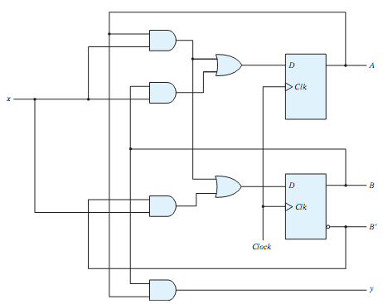
Step4: Draw Circuits
Using K-Maps
A(t + 1) = D_{A} = ∑(3,5,7) = A x + B x
B(t + 1) = D_{B} = ∑(1,5,7) = A x + B’ x
y = ∑(6,7) = A B
Example: Design a circuit that detects a sequence of three consecutive 1’s in a string of bits coming through an input line (serial bit stream)
AASTU/Software Engineering

Slide 57
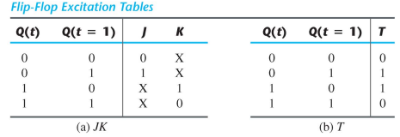
Design with Other types of FF
In designing with D-FFs, the input equations are obtained from the next state (simple!)
It is not the case when using JK-FF and T-FF !
Excitation Table: Lists the required inputs that will cause certain transitions.
  Characteristic tables used for analysis, while excitation tables used for design
+
+
AASTU/Software Engineering

Slide 58
Example 1
Problem: Design of A Sequence Recognizer
Design a circuit that reads as inputs continuous bits, and generates an output of ‘1’ if the sequence (1011) is detected
X
Y
Input 1 1 1 0 0 1 0 0 1 0 0 1 1 0 1 1 0 1 0 1 1 0 1 1 1 1 1 1
Output 0 0 0 0 0 0 0 0 0 0 0 0 0 0 0 1 0 0 0 0 1 0 0 1 0 0 0 0
AASTU/Software Engineering

Slide 59
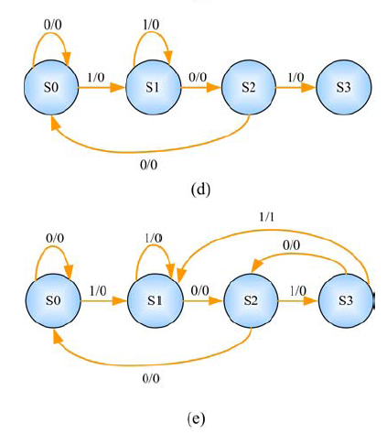
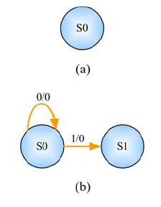
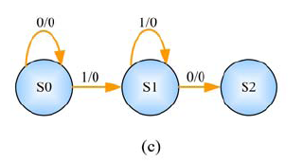
Example 1 (cont.)
Step1: State Diagram
Sequence to be detected:1011
AASTU/Software Engineering

Slide 60
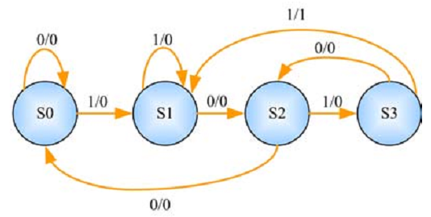
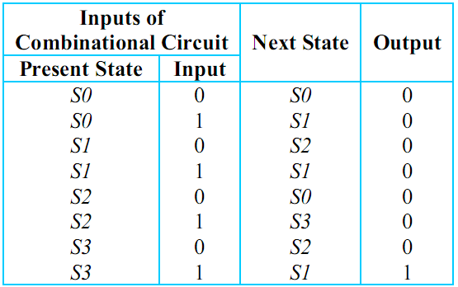
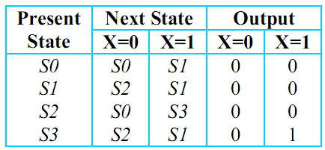
Example 1 (cont.)
Step 2: State Table
OR
AASTU/Software Engineering

Slide 61
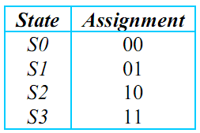
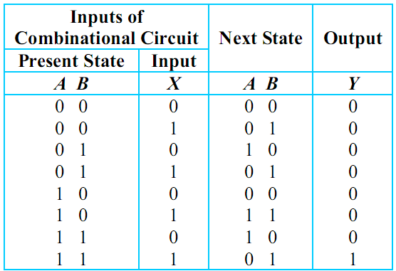
Example 1 (cont.)
Step 2: State Table
state assignment
Q: How many FF?
log₂(no. of states)
AASTU/Software Engineering

Slide 62
Example 1 (cont.)
Step 2: State Table
choose FF
In this example, lets use JK–FF for A and D-FF for B
AASTU/Software Engineering

Slide 63
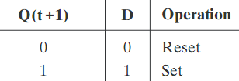
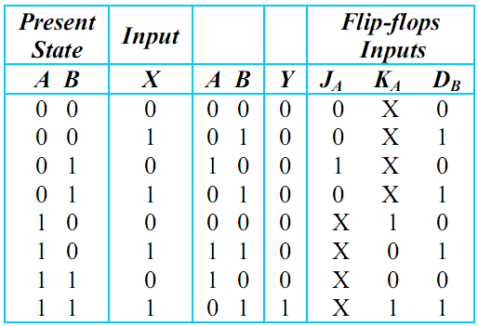
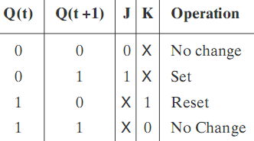
Example 1 (cont.)
Step 2: State Table
complete state table
use excitation tables for JK–FF and D-FF
D–FF excitation table
Next
State
output
JK–FF excitation table
AASTU/Software Engineering

Slide 64
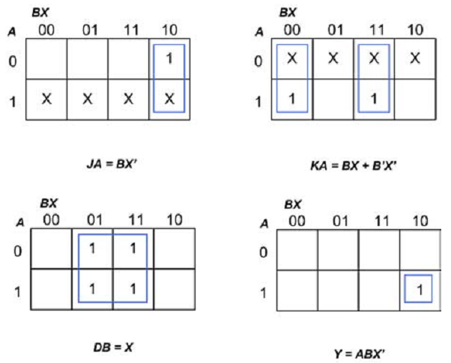
Example 1 (cont.)
Step 3: State Equations
use k-map
J_{A} = BX’
K_{A} = BX + B’X’
D_{B} = X
Y = ABX’
AASTU/Software Engineering

Slide 65
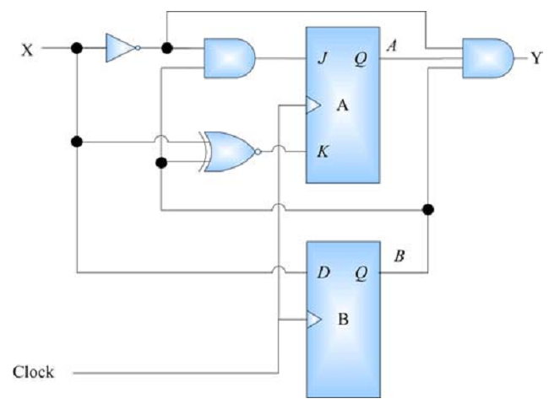
Example 1 (cont.)
Step 4: Draw Circuit
J_{A} = BX’
K_{A} = BX + B’X’
D_{B} = X
Y = ABX’
AASTU/Software Engineering

Slide 66
Example 2
Problem: Design of A 3-bit Counter
Design a circuit that counts in binary form as follows 000, 001, 010, … 111, 000, 001, …
AASTU/Software Engineering

Slide 67
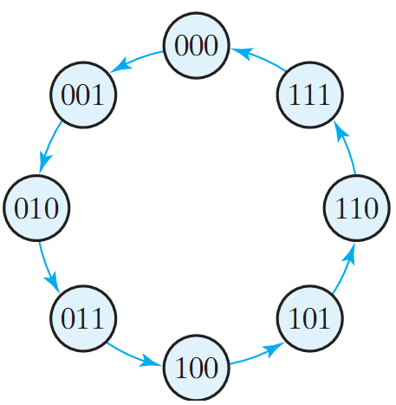
Example 2 (cont.)
Step1: State Diagram
The outputs = the states
Where is the input?
What is the type of this sequential circuit?
AASTU/Software Engineering

Slide 68
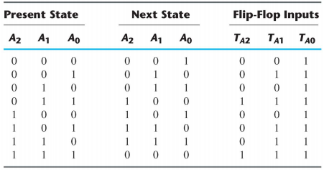
Example 2 (cont.)
Step2: State Table
No need for state assignment here
AASTU/Software Engineering

Slide 69
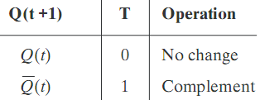
Example 2 (cont.)
Step2: State Table
We choose T-FF
T–FF excitation table
0
AASTU/Software Engineering

Slide 70
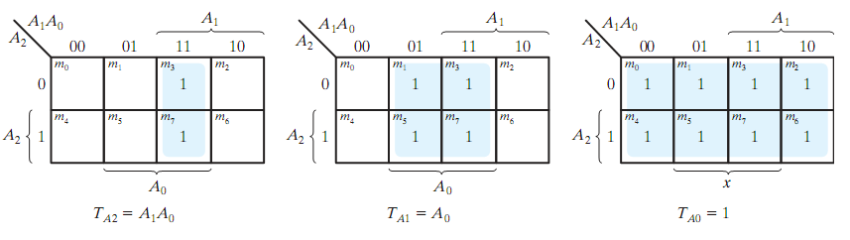
Example 2 (cont.)
Step3: State Equations
AASTU/Software Engineering

Slide 71
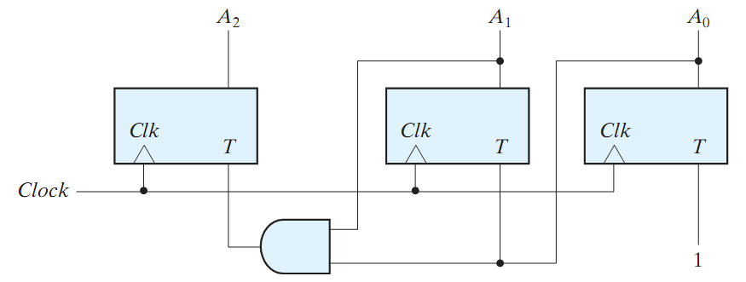
Example 2 (cont.)
Step4: Draw Circuit
T_{A0} = 1
T_{A1} = A₀
T_{A2} = A₁A₀
AASTU/Software Engineering

